Slide 1
Updates to FLSA Overtime Regulations
Human Resources Administration, Policy Team
October 2019

Slide 2
FLSA Overtime Updates
To be exempt from overtime:
All three prongs must be met to be exempt from overtime.
Paid on salary basis
Satisfy “duties test”
Meet salary threshold

Slide 3
FLSA Overtime Updates
NOTE:
Certain professional employees are not subject to the salary basis or salary threshold.
The USDOL receives authority through the FLSA to update the regulations on overtime exemptions.

Slide 4
FLSA Overtime Updates
New Regulations Effective January 1, 2020
Salary threshold will be set at the 20th percentile of all full-time employees
Salary threshold increases from $455/week ($23,600/year) to $684/week ($35,568/year)

Slide 5
FLSA Overtime Updates
New Regulations Effective January 1, 2020
Highly compensated employee exemptions salary threshold increases from $100,000/year to $107,432/year
DOL to review salary thresholds on a regular bbasis; no automatic adjustments

Slide 6
FLSA Overtime Updates
New Regulations Effective January 1, 2020
Non-discretionary bonuses, incentive payments, and commissions (paid at least annually) can be used to calculate up to 10% of the standard threshold
Catch-up payment permitted at the end of the 5252-week period

Slide 7
FLSA Overtime Updates
New regulations do not:
Make changes to the salary basis prong
Make changes to the duties prong
Interesting Facts:
Over 116,000 comments were received by USDOL, which also conducted “listening sessions” in several cities prior to issuing the proposed rule.

Slide 8
FLSA Overtime Updates
What should we do to prepare?
(1) Identify all employees who will be affected
Currently classified as exempt
AND
Earning less than $35,568 per year

Slide 9
FLSA Overtime Updates
What should we do to prepare?
(2) Track hours for all employees identified to be reclassified as nonexempt
Identify the number of hours that will be considered overtime
Determine if the overtime hours can be managed to a minimum

Slide 10
FLSA Overtime Updates
What should we do to prepare?
(3) Review current standards or policies that may need to be changed
Use of agency-issued communication devices (laptops, cellphones, tablets, etc.)
Telework policies or practices
Policies on requirements for working overtime (over 40 hours per week)

Slide 11
FLSA Overtime Updates
What should we do to prepare?
(4) Create a time line for change management activities to ensure compliance with January 1, 2020 effective date
Develop a list of the changes and draft a plan for how your agency will respond
Prepare early to ensure timely compliance

Slide 12
FLSA Overtime Updates
What should we do to prepare?
(5) Prepare managers and supervisors
Communicate with employees about the changes
Answer employee questions
Possibly reclassify some managers/supervisors

Slide 13
FLSA Overtime Updates
What should we do to prepare?
(6) Communicate upcoming changes
Determine communication techniques suitable for workforce, hours of business, and locations
Consider how affected employees may perceive the changes
Convey that changes are federal law mandates applying to all employers

Slide 14
Effects of FLSA Overtime Updates
Require reclassification of previously exempt employees to nonexempt status
Both exempt and nonexempt in same job
Potential to cause previously unexpected overtime
New monitoring responsibilities

Slide 15
FLSA Overtime Updates
Consequences of misclassifying an employee as exempt:
Back wages and overtime compensation owed
Attorney’s fees
Potential for class action
Additional penalties for willful violations

Slide 16
Updating FLSA Status
Agencies/entities must make required system changes in their HR/Payroll system during the month of November 2019 and complete the updates by November 30, 2019.
To assist with understanding the process of making position changes in TeamWorks HCM, see the job aid titled How to Make Required FLSA Changes.

Slide 17
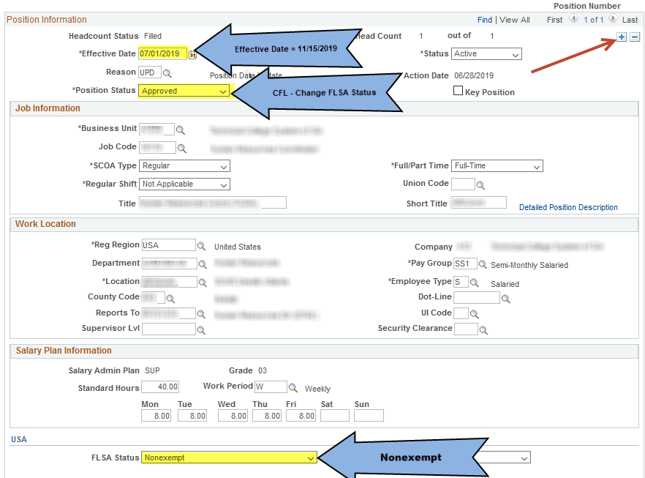
Updating FLSA Status

Slide 18
404-656-2705
www.doas.ga.gov
HRA Policy
policy@doas.ga.gov

